Slide 1

Compiler Design
Preet Kanwal
Department of Computer Science & Engineering
Teaching Assistant : Kavya P K

Slide 2

Compiler Design
Unit 3: Syntax Directed Definitions
Preet Kanwal
Department of Computer Science & Engineering

Slide 3
Compiler Design Lecture Overview
In this lecture, you will learn about -
S–Attributed SDD Examples :
To generate Syntax tree for Expressions
To generate Syntax tree for Statements

Slide 4
Compiler Design
Example 1 - SDD to generate Syntax tree for Expressions
Production | Semantic Rule
E -> E₁ + T | { E.node = new Node( ‘+’ , E₁.node, T.node); }
E -> E₁ - T | { E.node = new Node( ‘-’ , E₁.node, T.node); }
E -> T | { E.node = T.node ; }
T -> ( E ) | { T.node = E.node ; }
T -> id | { T.node = new Leaf( id , id.entry); }
T -> num | { T.node = new Leaf( num , num.lexval); }

Slide 5
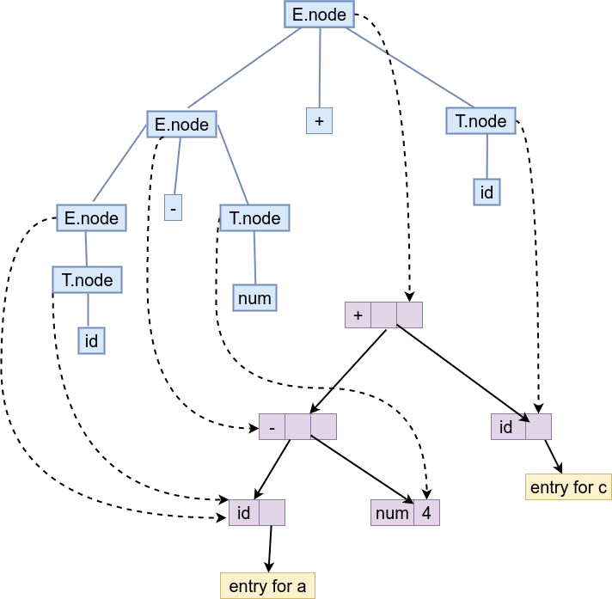
Compiler Design
Example 1 - SDD to generate Syntax tree for Expressions
Use the previous grammar to construct the syntax tree for the input a - 4 + c

Slide 6
Compiler Design
Example 2 - SDD to generate Syntax tree for Statements
Production | Semantic Rule
Stmt -> S Stmt | { Stmt.node = new Node(Seq, S.node, Stmt.node); }
Stmt -> S | { Stmt.node = S.node; }
S -> if (cond) { Stmt } | { S.node = new Node(if, Cond.node, Stmt.node); }
S -> while (cond) { Stmt } | { S.node = new Node(while, Cond.node, Stmt.node); }
S -> AssignExpr | { S.node = AssignExpr.node ; }
Cond -> E₁ > E₂ | { Cond.node = new Node( >, E₁.node, E₂.node); }
Cond -> E₁ < E₂ | { Cond.node = new Node( <, E₁.node, E₂.node); }
Cond -> E₁ || E₂ | { Cond.node = new Node( ||, E₁.node, E₂.node); }
Cond -> E₁ && E₂ | { Cond.node = new Node(&&, E₁.node, E₂.node); }
AssignExpr -> id = E; | { AssignExpr.node = new Node(=, new Leaf(id,id.entry), E.node); }

Slide 7
Compiler Design
Example 2 - SDD to generate Syntax tree for Statements
Production | Semantic Rule
… | …
E → E₁ + T | { E.node = new Node( ‘+’ , E₁.node, T.node); }
E → T | { E.node = T.node; }
T→ T₁ * F | { T.node = new Node( ‘*’ , T₁.node, F.node); }
T → F | { T.node = F.node; }
F → id | { F.node = new Leaf( id , id.entry); }
F → num | { F.node = new Leaf( num , num.lexval); }

Slide 8
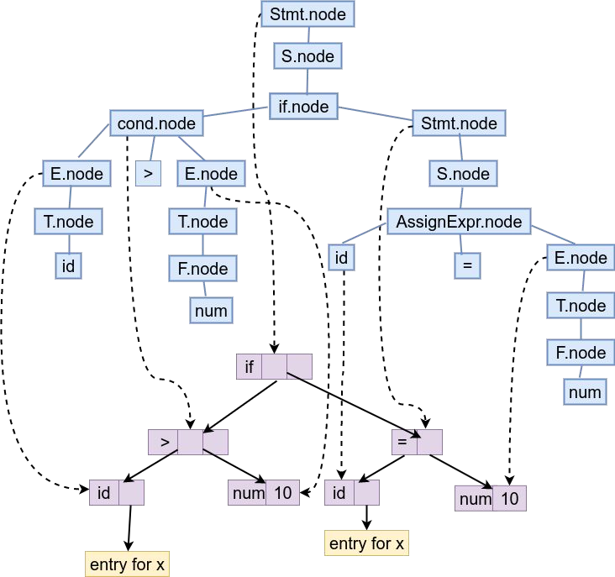
Compiler Design
Example 2 - SDD to generate Syntax tree for Statements
Use the previous grammar to construct the syntax tree for the input
if ( x > 10 )
{
x = 10;
}

Slide 9
THANK YOU
Preet Kanwal
Department of Computer Science & Engineering
preetkanwal@pes.edu

